Slide 1
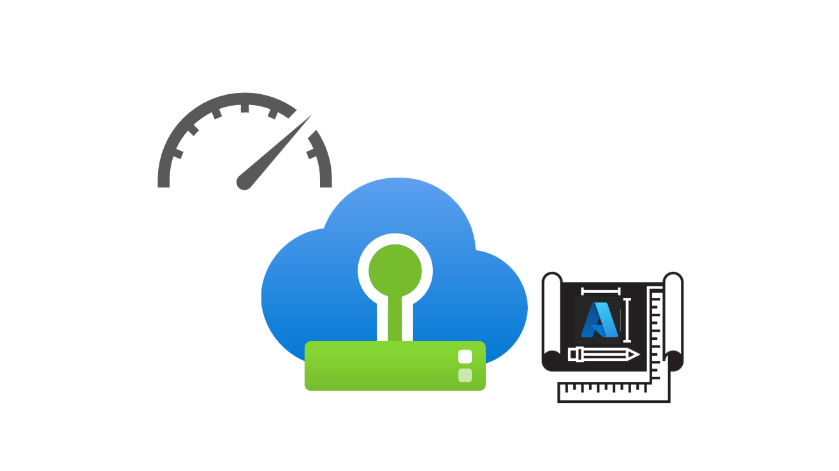
Azure VMware Solution Performance Design Template

Slide 2








Users
Traffic Flow
Load Balancer Layer
Application
Performance
Requirements
LB 1
LB 2
Web Layer
Web 1
Web 2
Web 3
App Layer
App 1
App 2
App 3
Database Layer
DB 1
(R/W)
DB 2
(R)
DB 3
(R)
Figure 1 – Typical Legacy Business-Critical Application Architecture

Slide 3










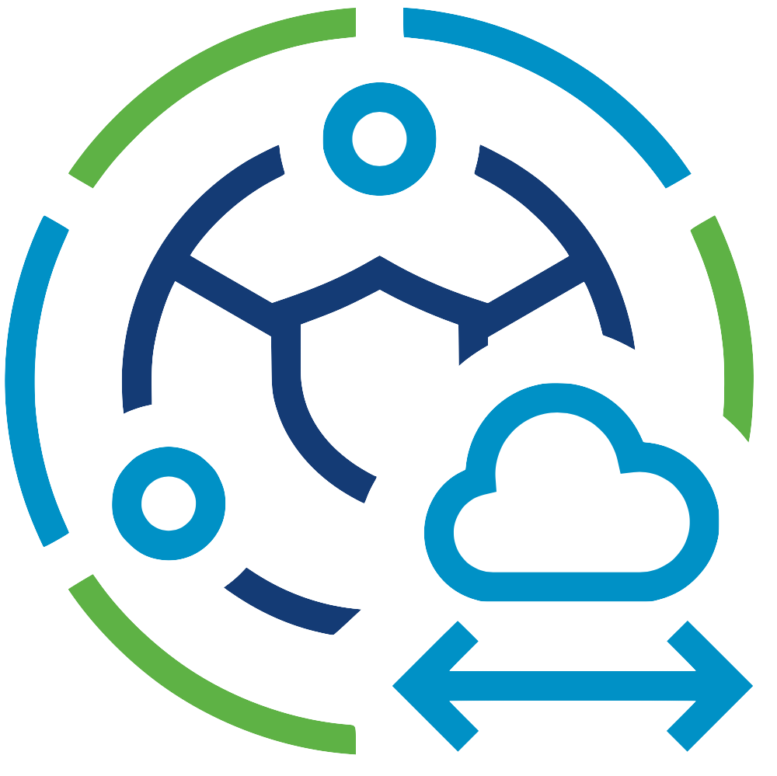




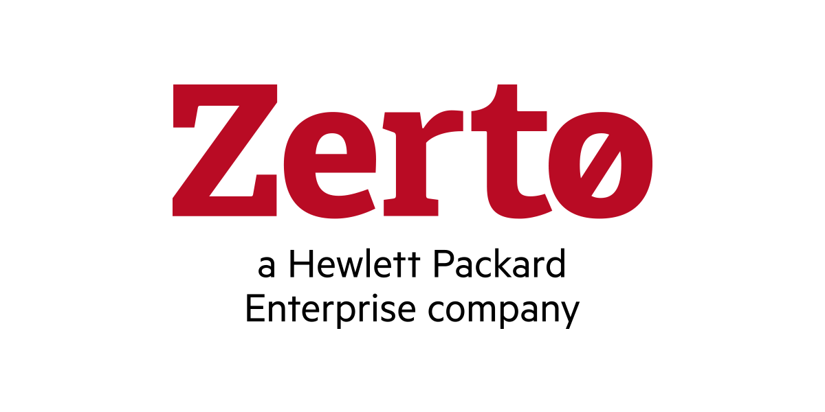




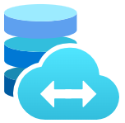
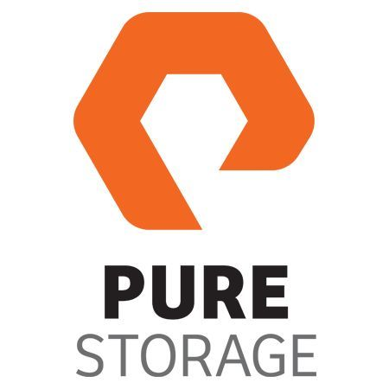
Microsoft Azure
Azure Subscription
Azure ExpressRoute
Dedicated Microsoft
Enterprise Edge
Azure Region
Azure Virtual Network
Azure Virtual WAN
Azure Resource Group
Azure Route Server
Azure Virtual Network
Gateway
Azure VMware Solution
Private Cloud
VMware HCX
VMware SRM
Azure VMware Solution
Resource Cluster
Zerto DR
VMware
vCenter Server
VMware NSX
JetStream
DR
Azure Bare-Metal
ESXi hosts
VMware
vSAN Datastore
Azure Bare-Metal
ESXi hosts
VMware
vSAN Datastore
Azure NetApp Files
Azure Elastic SAN
Pure Cloud Block Store
Figure 2 – Azure VMware Solution Architectural Components

Slide 4





Microsoft Azure
Single AZ in an Azure Region
Co-locate dependent services together to
provide the highest throughput and lowest latency
Azure VMware Solution
Private Cloud
Azure VNet
3rd Party Backup/Recovery Solution
Gold SLA Apps
Azure VMs
Silver SLA Apps
Azure Blob Storage
Bronze SLA Apps
Azure NetApp Files
ANF volume mounted as Datastore in Azure VMware Solution
Figure 3 – Azure VMware Solution Availability Zone Placement for Performance

Slide 5

Microsoft Azure
Azure VMware Solution
Private Cloud
Azure ExpressRoute
Dedicated Microsoft
Enterprise Edge (D-MSEE)
Azure Dell
Bare-Metal
ESXi hosts
VMware
vSAN Datastore
VMware
vCenter Server
VMware NSX
Cluster-1 needs three AV36, AV36P, or AV52 nodes in a supported Azure region
VMware NSX
Edges
Azure Network Backbone
AV64 can be used for Clusters 2 to 12
Azure AV64
Bare-Metal
ESXi hosts
Figure 4 – AV64 Mixed SKU Topology

Slide 6
Microsoft Azure
Single AZ in an Azure Region
Single Azure Subscription
Azure VMware Solution
Private Cloud
Cluster-1 (Management & Control Plane Cluster)
Azure Bare-Metal
ESXi hosts
VMware
vSAN Datastore
VMware
vCenter Server
VMware NSX
VMware NSX
Edges
VMware HCX
VMware SRM
Gold SLA Apps
Silver SLA Apps
Bronze SLA Apps
Enterprise
Services
Cluster-2 -> Cluster-12 (Resource Clusters)
Azure Bare-Metal
ESXi hosts
VMware
vSAN Datastores
Gold SLA Apps
Silver SLA Apps
Bronze SLA Apps
Figure 5 – Azure VMware Solution Mixed Workloads Topology

Slide 7
Microsoft Azure
Single AZ in an Azure Region
Single Azure Subscription
Azure VMware Solution
Private Cloud
Cluster-1 (Management & Control Plane Cluster)
Enterprise
Services
Cluster-2 (Gold SLA)
Cluster-3 (Silver SLA)
Gold SLA Apps
Silver SLA Apps
Cluster-4 (Bronze SLA)
Bronze SLA Apps
Figure 6 – Azure VMware Solution Dedicated Clusters Topology

Slide 8
Microsoft Azure
Azure VMware Solution
Private Cloud (Gold SLA)
Azure VMware Solution
Private Cloud (Silver SLA)
Gold SLA Apps
Silver SLA Apps
Azure VMware Solution
Private Cloud (Bronze SLA)
Bronze SLA Apps
Figure 7 – Azure VMware Solution Dedicated Private Cloud Instances Topology

Slide 9

Microsoft Azure
Use Azure VNet Gateway Ultra performance SKU or higher to enable FastPath for
highest throughput and lowest latency
Azure
VNet Gateway
Ultra perf. SKU
Azure VMware Solution
Private Cloud
Azure VNet
ExpressRoute Connection
3rd Party Backup/Recovery Solution
Dedicated
Microsoft
Enterprise
Edge
(D-MSEE)
Gold SLA Apps
Azure
ExpressRoute
Azure
ExpressRoute
Azure VMs
Silver SLA Apps
Azure Blob Storage
Bronze SLA Apps
Azure NetApp Files
ANF volume mounted as Datastore in Azure VMware Solution
Figure 8 – Azure VMware Solution connected to VNet Gateway with FastPath

Slide 10
Microsoft Azure
Single Azure Region
Azure VMware Solution
Private Cloud A
Use AVS Interconnect for highest throughput and lowest latency
between private clouds in same Azure Region
Azure VMware Solution
Private Cloud B
AVS Interconnect 1
AVS Interconnect
Mesh
Gold SLA Apps
Gold SLA Apps
AVS Interconnect 2
AVS Interconnect 3
Silver SLA Apps
Silver SLA Apps
Azure VMware Solution
Private Cloud C
Bronze SLA Apps
Bronze SLA Apps
Gold SLA Apps
Silver SLA Apps
Bronze SLA Apps
Figure 9 – Azure VMware Solution with AVS Interconnect

Slide 11
Microsoft Azure
Azure Region 1
Azure Region 2
Azure VMware Solution
Private Cloud A
Azure VMware Solution
Private Cloud B
D-MSEE
D-MSEE
Gold SLA Apps
Gold SLA Apps
Global
Reach
Silver SLA Apps
Azure
ExpressRoute
Azure
ExpressRoute
Silver SLA Apps
Bronze SLA Apps
Bronze SLA Apps
Figure 10 – Azure VMware Solution with ExpressRoute Global Reach

Slide 12
Microsoft Azure
Azure
ExpressRoute
Azure VMware Solution
Private Cloud A
(Stretched Clusters)
D-MSEE
AZ1
On-Premises vSphere Environment
Azure
ExpressRoute
Global Reach
Gold SLA Apps
VMware
vCenter Server
Bare-Metal
ESXi hosts
Edge
Router
Microsoft
Enterprise Edge
(MSEE)
Silver SLA Apps
D-MSEE
AZ2
Azure
ExpressRoute
Gold SLA Apps
Silver SLA Apps
Bronze SLA Apps
Bronze SLA Apps
Figure 11 – Azure VMware Solution with ExpressRoute Global Reach to On-premises vSphere infrastructure

Slide 13
Microsoft Azure
Azure VMware Solution
Private Cloud
Cluster-1 (Management & Control Plane Cluster)
VMware NSX
Use NSX Multi-Edge to increase throughput by using the 2x 25GbE uplinks of additional hosts.
NSX Edge Cluster with VM-VM anti-affinity rules
VMware NSX
Edge A
VMware NSX
Edge B
VMware NSX
Edge C
VMware NSX
Edge D
Azure Bare-Metal
ESXi host 1
Azure Bare-Metal
ESXi host 2
Azure Bare-Metal
ESXi host 3
Azure Bare-Metal
ESXi host 4
Figure 12 – Azure VMware Solution Multi-Edge

Slide 14
Microsoft Azure
Internet
Azure PIP range is advertised to Internet with ASN of NSX Tier-0 Gateway
Traffic flow
Azure
ExpressRoute
Azure VMware Solution
Private Cloud
BGP ASN
VMware NSX
Tier-0 Gateway
Azure PIP range needs to be consumed within the Tier-1 Gateway or Network Segment
Azure Public IP
Address Range
Tier-1 Gateway
Figure 13 – Azure VMware Solution Public IP Address with NSX-T Data Center

Slide 15
Microsoft Azure
Azure VMware Solution
Private Cloud
Cluster-1
Web 1
Web 2
Web 3
App 1
App 2
App 3
DB 1
DB 2
DB 3
“Web-App-DB1”
VM-Host Affinity
Placement Policy
“Web-App-DB2”
VM-Host Affinity
Placement Policy
“Web-App-DB3”
VM-Host Affinity
Placement Policy
ESXi host 1
ESXi host 2
ESXi host 3
ESXi host 4
ESXi host 5
ESXi host 6
Figure 14 – Azure VMware Solution Placement Policies

Slide 16
Microsoft Azure
Single AZ in an Azure Region
Azure VMware Solution
Private Cloud
Azure ExpressRoute
Gateway
Azure VNet
ExpressRoute Connection
Azure NetApp Files
Dedicated
Microsoft
Enterprise
Edge
(D-MSEE)
Gold SLA Apps
Azure
ExpressRoute
Azure
ExpressRoute
ANF volume mounted as Datastore in Azure VMware Solution
Silver SLA Apps
Bronze SLA Apps
Figure 15 – Azure VMware Solution External Datastores with Azure NetApp Filer

Slide 17



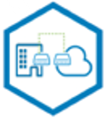
Microsoft Azure
Single AZ in an Azure Region
Single Azure Subscription
Azure VMware Solution
Private Cloud
Cluster-1 (Management & Control Plane Cluster)
VMware HCX
Manager Appliance
Enterprise
Services
Cluster-2 (Mobility)
Cluster-3 (Gold SLA)
VMware HCX
IX Appliance
VMware HCX
WO Appliance
VMware HCX
NE Appliance
Gold SLA Apps
Cluster-4 (Silver SLA)
Cluster-5 (Bronze SLA)
Silver SLA Apps
Bronze SLA Apps
Figure 16 – VMware HCX with Dedicated Mobility Cluster

Slide 18
Microsoft Azure
Dual AZs in an Azure Region
Single Azure Subscription
AZ1 – Preferred Site
AZ2 – Secondary Site
Azure VMware Solution
Private Cloud A
Stretched vSAN Datastore
Azure Bare-Metal
ESXi hosts
VMware
vSAN Datastore
Preferred
Fault Domain
VMware
vCenter Server
VMware NSX
Azure Bare-Metal
ESXi hosts
VMware
vSAN Datastore
Secondary
Fault Domain
VMware NSX
Edge A
VMware HCX
Gold SLA Apps
VMware NSX
Edge B
Gold SLA Apps
Silver SLA Apps
Bronze SLA Apps
Policy-based Synchronous Replication
AZ3 – Witness Site
VMware vSAN
Witness Appliance
Figure 17 – Azure VMware Solution Private Cloud with Stretched Clusters

